Slide 1
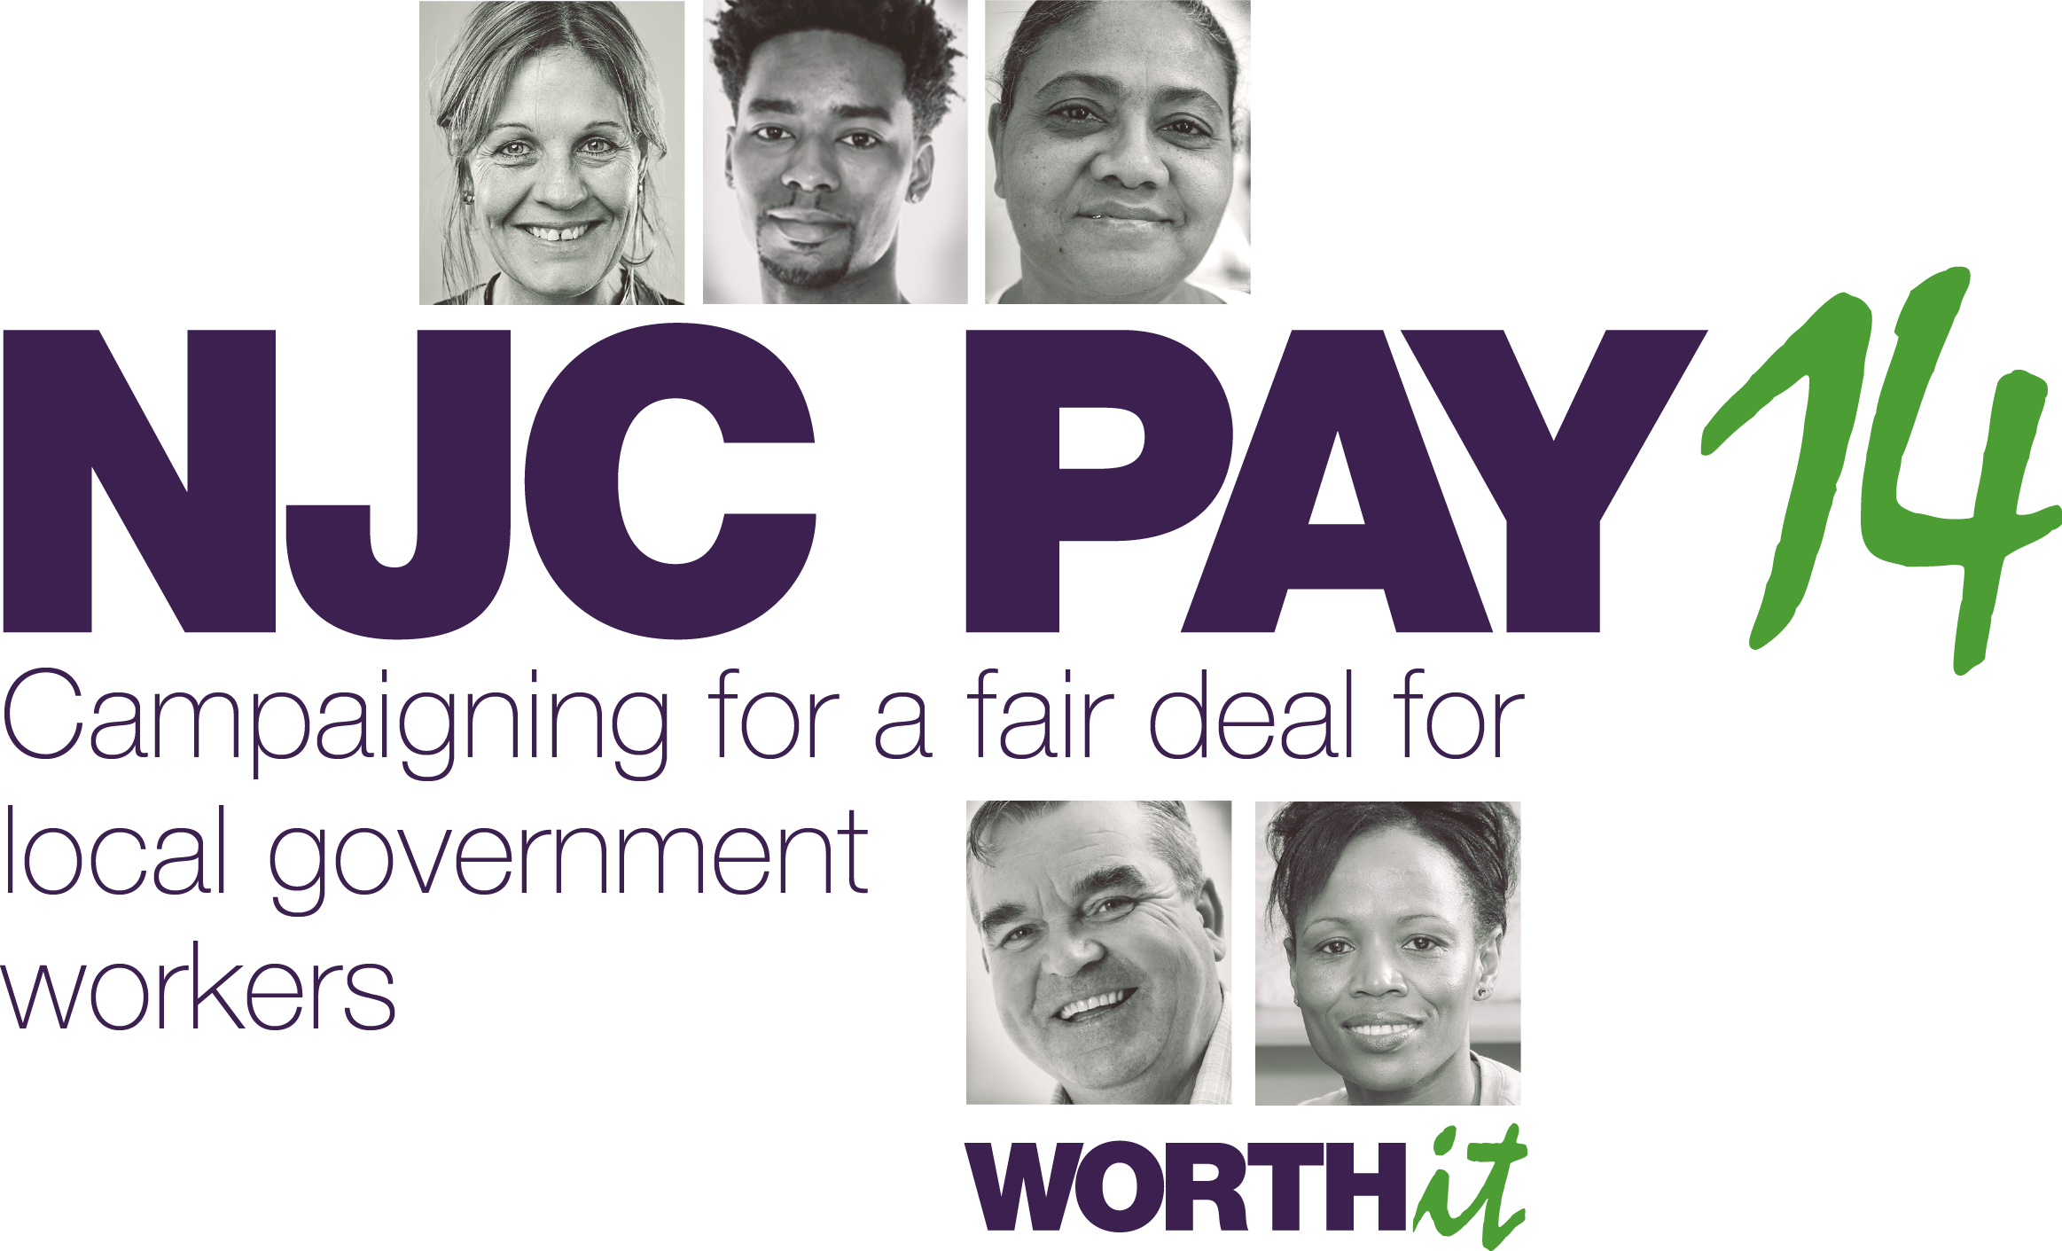

Slide 2
The 2014-15 pay claim
A minimum increase of £1 an hour on scale point 5 to achieve the Living Wage and
the same flat rate increase on all scale points.
The Living Wage has risen to £7.65 an hour, so we would need an increase of £1.20 on scale point 5 to reach it.

Slide 3
What an extra £1 would mean for you
SCP | 1 April 2013 |  | 1 April 2014
 | per year | per hour | per year | per hour
5 | £12,435 | £6.45 | £14,759 | £7.65
10 | £14,013 | £7.26 | £16,322 | £8.46
20 | £18,638 | £9.66 | £20,951 | £10.86
30 | £25,727 | £13.33 | £28,033 | £14.53
40 | £33,998 | £17.62 | £36,309 | £18.82
49 | £42,032 | £21.79 | £44,352 | £22.99

Slide 4
Local government workers
1.6 million on NJC pay and conditions in local government.
77% are women.
55% are part-time workers – over 90% of them are women.
Hourly basic pay gap of ⅓ between equivalent full-time and part-time workers.

Slide 5
Why our claim is a fair claim
The real value of your pay has fallen by 18% since 2010.
Half a million local government workers earn less than the Living Wage – that’s 30% of the workforce.
Over 1 million earn less than £21,000 – the Coalition’s own low pay threshold.
Everyone on NJC pay is low paid for the job they do.
Local government pay and conditions are the worst in the public sector.

Slide 6
More for less
Cost of living rises, a three-year pay freeze and 1% this year means you are doing more for less.
407,000 jobs lost in local government since 2010 means heavier workloads.
Vacant and frozen posts not being filled either.
Stress levels are rising and morale is falling.
Fuel, travel, food prices and childcare costs are all rising.

Slide 7
Half a million earn less than the living wage
The Living Wage: the bare minimum for an acceptable standard of living.
£7.65 outside London and £8.80 in London.
Over half a million local government workers earn less.
In the NHS only 22,000 earn as little.
It’s a scandal!

Slide 8
Below the Living Wage:
Impact of inflation on pay since 2009 for SCP10

Slide 9
Living Wage: support is growing!
28% of councils have already brought in a living wage, 41% are considering it and 7% have it under review or already pay more.
Political leaders from all parties support the living wage.
60% of the public think the National Minimum Wage should be
raised to the level of the Living Wage.
Recent research shows that this would increase tax and NI income
by £1.3 billion – and make savings on the benefits bill.
The tax payer is subsidising poverty wages - it makes no sense!

Slide 10
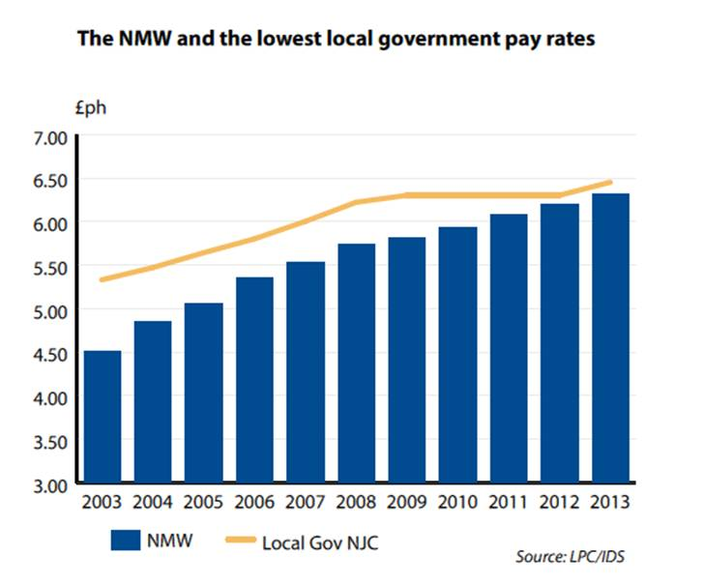
If the NMW increases as much as many politicians would like, it will be between 49p – 62p above the bottom NJC pay rate of £6.45 per hour.
If

Slide 11
Its not just the lowest paid struggling...
… everyone is worse off now than in 2009

Slide 12
Poor relations of the public sector
Local Government has the worst pay and conditions in the whole of the public sector for comparable jobs.
From the bottom of the pay spine through to the top.
Cleaners and catering assistants earn about £800 a year (6%) more in the NHS.
And about £950 a year (7%) more in the police service.

Slide 13
Comparing NJC and NHS pay
NHS | NJC | NJC | NHS
Job title | Job title | Average salary | Average salary | Difference between NJC and NHS | % NHS pay higher than NJC Pay
Domestic support worker | Cleaner | £14,003 | £14,813 | £810 | 5.8%
Clinical support worker (higher level) | Community care assistant | £17,980 | £19,011 | £1,031 | 5.7%
Social worker | Social worker | £33,051 | £34,070 | £1,019 | 3.1%
Senior social worker | Senior social worker | £37,287 | £40,017 | £2,730 | 7.3%
Nursery nurse | Nursery worker | £17,983 | £21,722 | £3,739 | 20.8%

Slide 14
Cuts add insult to injury!
Shabby treatment by employers on pay and conditions:
Over 60% of councils have cut car allowances.
Many have cut unsocial hours and overtime.
Sick pay, basic pay and redundancy pay have been cut.
Others have imposed unpaid holidays and cut annual leave.
The Employers are coming hard for annual leave and sick pay.

Slide 15
The cuts don’t work!
The cuts are not necessary. They are making the deficit rise!
The crisis was caused by the unsafe and greedy practice of the banks and the finance sector – not public spending.
Cutting pay and jobs is not the answer. We need to get the economy working again.
Research shows that for every £1 a local government worker earns – 50 pence gets spent in their local economy.
Higher wages means more local spending - boosting local businesses, increasing tax and NI returns and creating jobs.
A pay rise for 1.6 million local government workers will make a big difference.

Slide 16
The employers will say...
...they can’t afford it. But...
Over the last three years councils saved a quarter of their staffing costs.
Their reserves rose from £2.6 billion to £19 billion!
The extra £2.6 billion last year alone would pay for a 10% pay increase.
They chose to boost reserves further instead of rewarding their overworked staff.

Slide 17
But there is an alternative
An increase in your pay of at least £1 an hour will:
Generate significant savings for the Treasury in benefits and tax credits.
Plus income from increased tax and national insurance.
Our claim could be funded by recycling these savings to local authorities in the 2014 budget.

Slide 18
What can you do?
Join in campaign activities organised by your branch.
Become an NJC pay ‘champion’ and help the campaign.
Write to your local councillor and MP – get them to support our claim.
Sign our Worth It! postcard to the Local Government Employers.
Follow us on Twitter: @LocalGovPay.
Join our facebook campaign:
facebook.com/UnisoninLocalGovernment

Slide 19
Recruit!.... We’re stronger together!
Talk to your work mates about what’s going on – let them know UNISON is fighting to win them a pay rise and defend their jobs.
If they’re not UNISON members sign them up – we’re stronger together.
It’s easy to join us – talk to your rep or join online:
www.unison.org.uk/for-members/joining-unison/

