Slide 1
UNISON Schools Survey 2017
West Sussex Funding Crisis

Slide 2
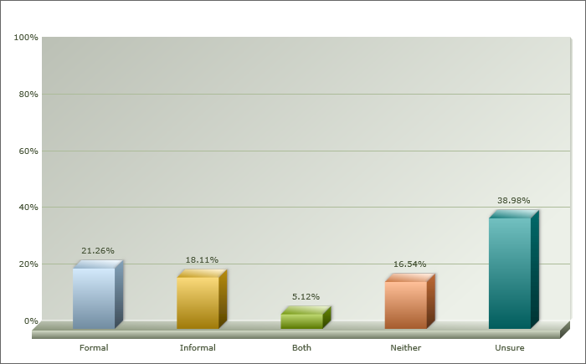
Responses and indication of an increasing rate of restructure
There were over 500 responses to the survey
45% respondents have been through a restructure with a further 38% unsure
Almost half, 46.8%, said the restructure had taken place in the last year against 28% in the previous year. This suggests an increasing rate.

Slide 3
Who were the respondents?
76% of respondents were UNISON members
48% Support Staff
27% Parents
10% Teachers
2% Heads, Governors, Business Managers

Slide 4
Over 80% said the restructure was financially driven
Schools in West Sussex receive £200 per pupil less than the national average.
Worth Less? campaign demanded £20m from government in transitional funding, refused.
New national funding formula delayed until 2018-19

Slide 5
Other than staffing, the survey asked what other savings had there been?
Resources 88%
Equipment 85%
Buildings 33%
Heating / ventilation 14%
Transport 13%

Slide 6
On the diminishing resources, one member said…
“Due to lack of funding there are limited resources and many resources that are available are very tired and worn.”

Slide 7
Do you feel the process was managed well? This should include support from management, proper consultation and selection for alternative roles?
Only 36% say the process was managed well.
27% say the process was not managed well.
36% say the process was ok.
UNISON is concerned about the worsening support from central services.

Slide 8
We asked respondents what impact the restructure had on them…
As a result of the restructure:
65% said it had lowered morale
44% said it had contributed to stress / health problems
48% said it had resulted in them having greater responsibility
78% said they had experienced increased workload

Slide 9
We asked respondents what impact the restructure had on them…
Reduction of SNTAs means I have to support special needs children in the class as well as keeping up with my usual role
“Although few were made redundant, many left because of the stress”
The role is poorly paid, frequently challenging and pay rises derisory…many colleagues openly discuss a desire to seek alternative employment and express low levels of satisfaction regarding, pay and conditions

Slide 10
The survey asked how many job losses there had been due to restructure…
80% said between 0-5 job losses
16% between 5 – 10
Almost 3% said more than 20
Less staff means more work for everybody who remains.

Slide 11
We asked if the number of staff needed to do the work had been impacted…
73% said that the number of staff needed to do the work was worse since the restructure.
UNISON is concerned about the gradual erosion of support staff in our schools. These staff provide much needed support to the most vulnerable children.

Slide 12
As a result of the restructure, has the number of staff needed to carry out the work in your school improved or got worse?
One Headteacher said:
“Everyone is stretched to the limits. In a school of social deprivation we are unable to offer the support to children and their families of previous years.”

Slide 13
As a result of the restructure, has the number of staff needed to carry out the work in your school improved or got worse?
“Some year 11 GCSE English classes were taught by unqualified support staff last academic year.”
“Staff feel that the quality of work they do has dropped as you don't have the time to do the job properly. You just rush-rush-rush”
“Classes have had to become mixed year groups across Y1/2 and Y3/4 due to lack of funding”
“The work is still there, but it does not get done in a timely manner or sometimes at all”

Slide 14
UNISON asked respondents about the impact on educational outcomes for children…
47% said educational outcomes in their school had got worse as a result of a restructure
“Much worse for children with additional needs, and worse for all our children as a result”

Slide 15
Impact on educational outcomes…
“There not enough qualified teachers, enough resources and in general the means to provide better educational outcomes for our Children.”
“Class sizes are too large, especially for lower ability pupils. Teachers are massively overworked and we are no longer able to give the support they need as there are too few of us.
“Statement hours not being met. All SEN pupils suffering”

Slide 16
We asked respondents whether there was an increased safeguarding risk as a result of restructure…
31% said they thought there was an increased risk to safeguarding as a result of restructure.
Less of our members on the ground means a greater risk for children in schools. This was reflected in the responses.
Notes:
Add responses

Slide 17
Impact on safeguarding…
“At lunchtimes there are insufficient staff to cope with the volume of children.”
“If support staff are used instead of a permanent teacher giving a stable environment for learning, then safeguarding issues can be overlooked.”
“There is little understanding or allowances made for the fact that we have high numbers if very young children and therefore need to maintain high ratios to maintain safety”
“Less staff means fewer people are looking out for the vulnerable students.”

Slide 18
We asked respondents what they thought the impact of the restructure was on SEN provision…
65% say special educational needs (SEN) provision has got worse as a result of restructure in their school
This is a shocking statistic. The most vulnerable are those most likely to suffer as a result of cut-backs.
Notes:
16. As a result of the restructure has Special Educational Needs (SEN) provision got better or worse, in your view?
Our members working as TAs are at the coalface when it comes to SEN. When schools are faced with the difficult decision of making cut-backs, it is our members targeted first. The assumption is that whilst teachers have to be preserved if there has to be staff losses then support staff are easier to let go. The problem with this attitude is it deprives those who most rely on Teaching Assistants, children with autism, learning difficulties and so on, of the resource they need to access education. This is a criminal dereliction of duty by this government who year on year fail to provide our schools in West Sussex with the money they need for all our children to access education.

Slide 19
Impact on SEN…
“Dedicated SEN HLTA now not being used for her specialism.”
“Some days we can now only cover statemented students, and assistant presence in smaller classes has also dropped.”
“There are now less staff to support children with additional needs. This has an impact on all the children we work with, not just those with additional needs.”
“When I started in 2007 there were over 10 LSAs now there are 6 of whom 2 are full time.”

Slide 20
As a result of the restructure has Special Educational Needs (SEN) provision got better or worse, in your view?
One Headteacher said:
“We have had to significantly reduce our intervention support, our numbers counts teacher is back in class and our high need children are receiving fewer hours support.”

Slide 21
We asked respondents to comment on the perceived risk to the health and safety of staff and children, as a result of restructure...
51% say there is now a greater risk to the Health and Safety of staff, children and other stakeholders
Taken together with cuts to equipment, heating etc, UNISON will press for more robust risk assessment.

Slide 22
We asked respondents to comment on the perceived risk to the health and safety of staff and children, as a result of restructure...
One Parent said:
“There are always going to be increased Health and Safety risks for everyone involved, when class sizes are forced to increase.”

Slide 23
Impact on Health and Safety…
“Hopefully high standards will remain but it is hard work. Stress will lead to sickness”
“In certain subjects the numbers are too high, especially in more difficult classes, which make practical components more of a risk”
“Stressed and overworked staff increases the risk of mistakes being made.”

Slide 24
There is no doubt our school and the opportunities for our children would improve with equal government funding; fair and equitable for our school and others in our part of the country

